Slide 1
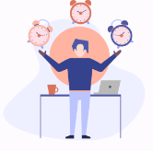
Schedule N
Get personalised time-management advice
Clare, Dela, Lina, Minhaj, Saba, Suliyat, Xinhao
Mentor: Matheus Cardoso & Tiago Ignacio

Slide 2


The problem we want to solve
Feeling of low productivity
Exhaustion from unbalance
Countless advice online…
Useless time planning
“But most of them don’t work for me!”

Slide 3

Our solution
We …
Classify users into different time management (TM) types
Match users with advice for his/her own type
Users …
Take a quiz
Find out his/her own TM type and get matching advice

Slide 4
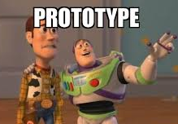
Our journey
Define problem space & solution
Questionnaire design/
User research
01
02
03
Data analysis/
Logo & colour/
First webpage
Data collection/
website design
05
04
TM type function/
High-fidelity wireframe/
Website built
Mergeing between FE, BE and DS/
User test
06
07
08

Slide 5
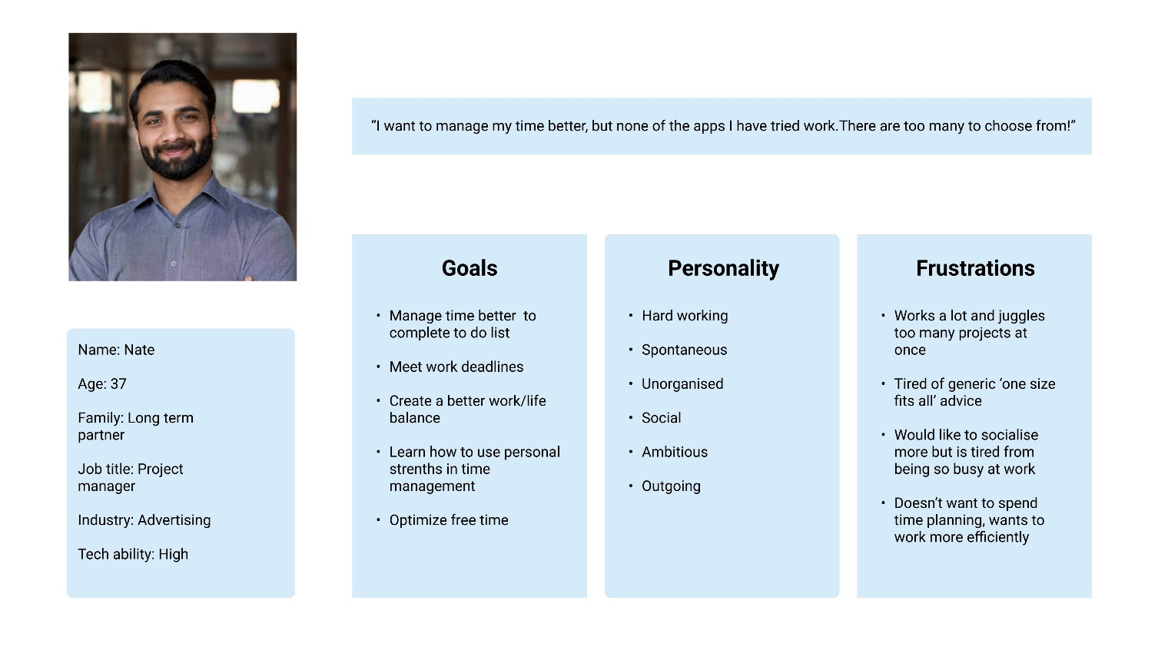
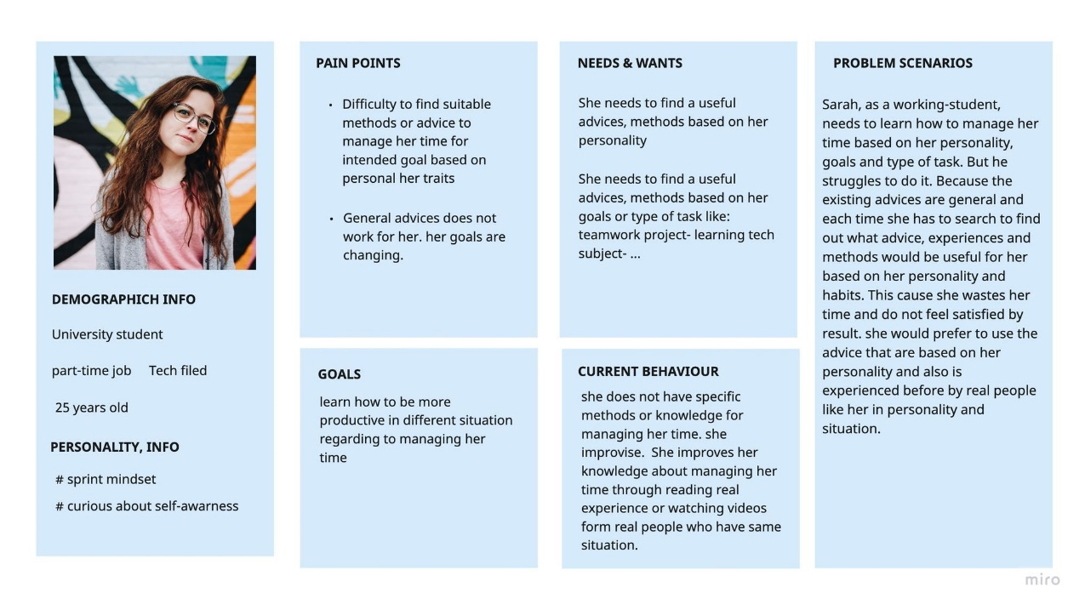
Our journey - UX
Define problem space and solution
Questionnaire design/
User research
01
02
03
Data analysis/
Logo & colour/
First webpage
Data collection/
website design
05
04
TM type algorithm/
High-fidelity wireframe/
Website built
Mergeing between FE, BE and DS/
User test
06
07
08

Slide 6
Our journey - DS
Define problem space and solution
Questionnaire design/
User research
01
02
03
Data analysis/
Logo & colour/
First webpage
Data collection/
website design
05
04
TM type function/
High-fidelity wireframe/
Website built
Mergeing between FE, BE and DS/
User test
06
07
08

Slide 7
Our journey - WD
Define problem space and solution
Questionnaire design/
User research
01
02
03
Data analysis/
Logo & colour/
First webpage
Data collection/
website design
05
04
TM type function/
High-fidelity wireframe/
FE & BE server
Mergeing between FE, BE and DS/
User test
06
07
08

Slide 8




… and challenges
Define problem space and solution
Rescource search/
Questionnaire design/
User persona
“where‘s our data?!“
“Is our quiz valid?“
01
02
03
Data analysis/
Logo & colour/
First webpage
Data collection/
website design
“what’s our real data format?”
05
04
TM type function/
High-fidelity wireframe/
Website built
Mergeing between FE, BE and DS/
User test
“how to apply DS function from BE?!”
“how to connect BE and FE?!”
06
07
08

Slide 9













Our prototype
Port:5000
UX/UI
Backend
Data Science
Frontend
Port:3000
Port:4000
Future Version

Slide 10





Tech Stack
UX
Frontend
Backend
DS

Slide 11
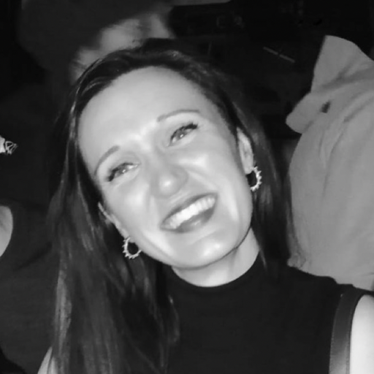
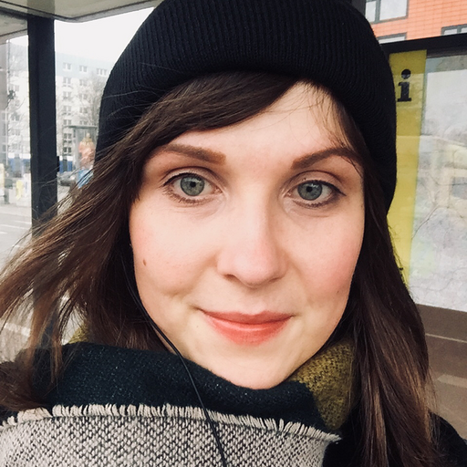
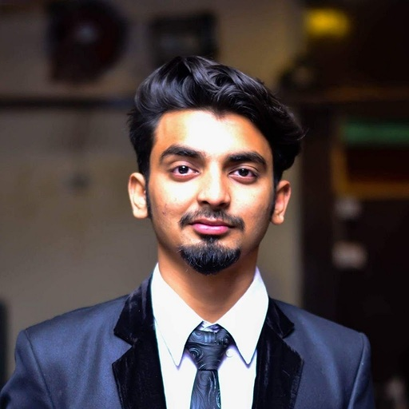

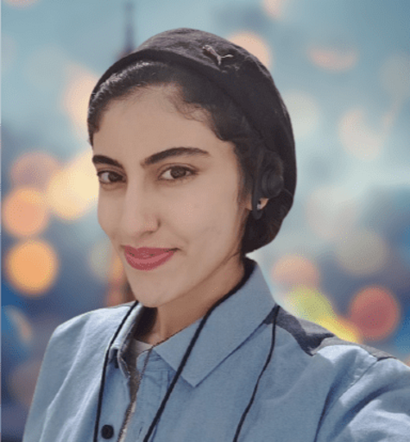
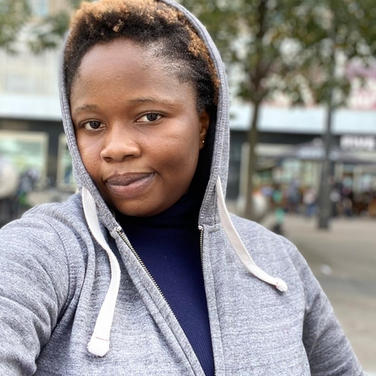
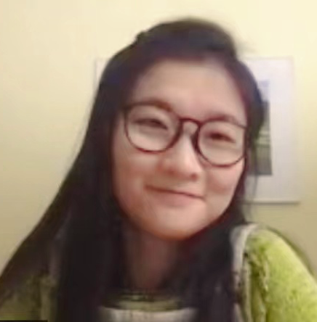

Our team
Saba
(UX)
Suliyat
(BE)
Xinhao
(DS)
Clare
(UX)
Lina
(FE)
Minhaj
(BE)
Dela
(DS)
Matheus
Tiago

Slide 12

Welcome to our website :)

